Slide 1
Quality Assurance in Software Development
Nur Wahira Mohd Fadzil Azri

Slide 2
Contents
1. QA Roles in Software Development
2. QA in Improving Software Testing
3. Test Case
4. Test Plan
5. Software Testing Life Cycle (STLC)
6. Importance of QA in Organization

Slide 3
QA Roles in Software Development
Quality Assurance (QA) is an area of production responsible for identifying problems and preventing failures through software testing with goal of delivering a high quality product to the end users that meet the requirements and expectations.

Slide 4
QA in Improving Software Testing
Execute tests with proper methods and document testing failures.
Interact with Business Analyst (BA), Project Manager, development team and client as per need.
Work along with the development team to evaluate or identify issues and suggest recommendations for possible solutions

Slide 5
Test Case
Test case is a document that may contain various parameters (i.e id, condition, steps, input, expected result, result, status and remarks)

Slide 6
Test Case
Examples :
Test Case ID | Test Scenario | Test Steps | Test Data | Expected Result | Actual Result | Pass/Fail
TC_LOGIN_01 | User sign in with valid email and invalid password | Go to site Enter email Enter password Click on Sign In | Email = wahira.fadzil@gmail.com Password = Dummy123 | Alert message will popup and user will not be able to sign in into the application | As expected | Pass

Slide 7
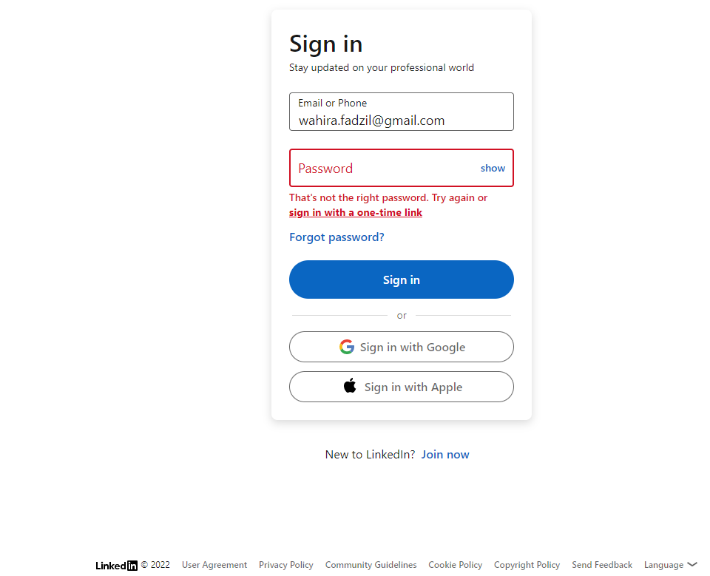

Slide 8
Test Case
Examples :
Test Case ID | Test Scenario | Test Steps | Test Data | Expected Result | Actual Result | Pass/Fail
TC_LOGIN_02 | User sign in with valid email and password | Go to site Enter email Enter password Click on Sign In | Email = wahira.fadzil@gmail.com Password = Wahira13 | User able to login and the homepage will be prompt | As expected | Pass

Slide 9
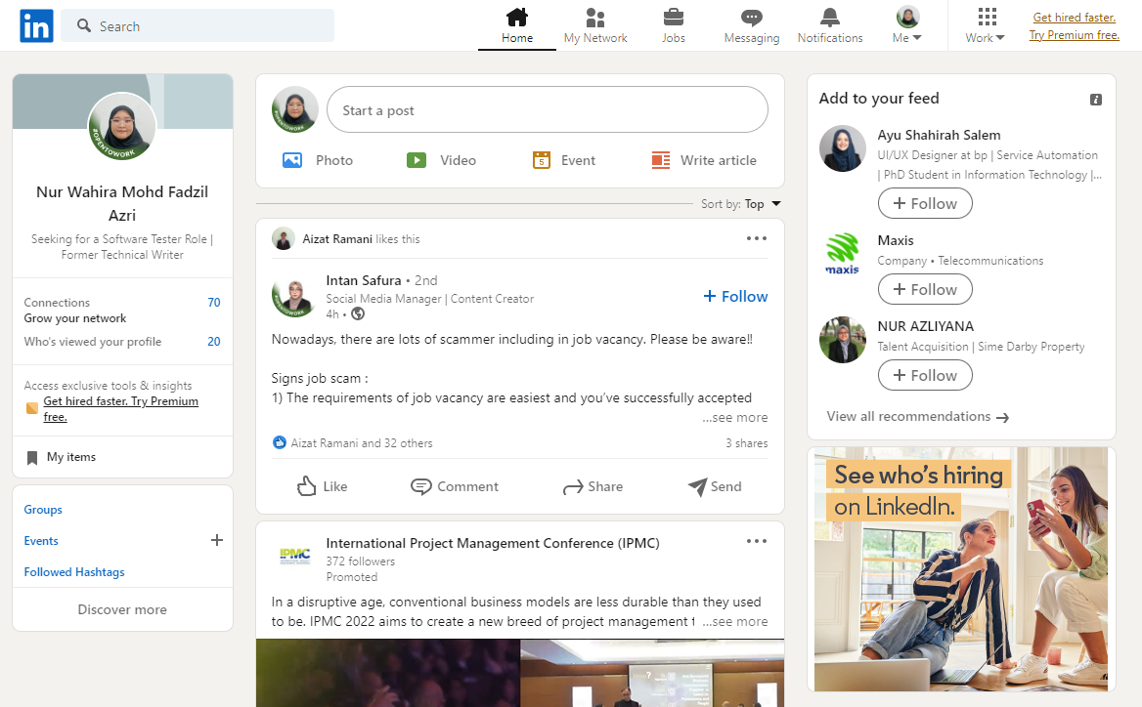

Slide 10
Test Plan
Test Plan is a detailed document that describes the test strategy, objectives, schedule, estimation, deliverables, and resources required to perform testing for a software product.

Slide 11
Test Plan
Analyze the product
Design Test Strategy
Define Test Objectives
Define Test Criteria
Resource Planning
Determine Test Deliverables
Schedule and Estimation
Plan Test Environement

Slide 12
Test Plan
1. Analyze the product
Learn more regarding the product such as who will use the product, main purpose of the product, how the product and the software and hardware specifications.
2. Design Test Strategy
Define on scope of testing, type of testing, risk and issues and test logistics.
3. Define Test Objectives
Define the goals and expected results from the test executed.

Slide 13
Test Plan
4. Define Test Objectives
Refers to standards or rules of governing all activities in testing with two main criteria which are Suspension Criteria and Exit Criteria.
5. Resource Planning
Breakdown of all resources required included human effort, equipments and other infrastructures.
6. Plan Test Environment
Refer to software and hardware setup that should be real devices in real user environment.

Slide 14
Test Plan
7. Schedule and Estimation
Breakdown the project into smaller tasks and allocate time and effort required followed by a schedule to complete the tasks in the designated time.
8. Determine Test Deliverables
Test Deliverables refer to list of documents, tools and other equipment that must be created, provided, and maintained to support testing activities in a project.

Slide 15
Software Testing Life Cycle (STLC)
The Software Testing Life Cycle (STLC) is a sequence of specific actions performed during the testing process to ensure that the software quality objectives are met. The STLC includes both verification and validation.

Slide 16
Software Testing Life Cycle (STLC)
Requirement Analysis
Test Planning
Test Case Development
Test Environment Setup
Test Cycle Closure
Test Execution

Slide 17
Software Testing Life Cycle (STLC)
1. Requirement Analysis
Identifies the potential need for automated testing and allows making economic calculations of labor costs based on the project estimation.
2. Test Planning
The actualization of all phases of the testing itself, timing, participants, and responsibilities.
3. Test Case Development
Using manual and automated testing to achieve full coverage of the software’s functionality and features, with the process being based on the requirements set up beforehand.

Slide 18
Software Testing Life Cycle (STLC)
4. Test Environment Setup
Operating systems and virtual machines are configured, testing tools and the project’s test environment and databases are deployed.
5. Test Execution
Tests are performed based on ready-made test documentation and a correctly configured test environment.
6. Test Cycle Closure
Generate testing reports for the client. These should include the time spent, the percentage of defects found to positive test results, the total number of errors found and fixed.

Slide 19
Importance of QA in Organization
QA play a vital role in ensuring the software is efficient, defect-free and meets customers’ needs closely. It is extremely important to incorporate QA into the overall software development lifecycle and to weave it into every stage of the process.

Slide 20
Thank You! For any enquiries, email me at : wahira.fadzil@gmail.com

